Slide 1
AI applications in Finance
Lecture 4
Introduction to Neural Networks
26-Nov-2020
Indranil Dutta

Slide 2
Recap
Types of learning
Supervised learning -> classification, regression.
Unsupervised learning -> clustering, association.
Network Parameters
Learning rate
Delta
Epoch
Batch
Activation function
Tools for implementing networks
Through code
Through stand alone tools
Through on-line platforms

Slide 3




Fun Fact(s) :
Amazon Go
Keep track of shopping activities
No check out.
Transactions immediate and online.
Disney
Is story appealing?
Data from social media site
Train Neural Nets to find popularity
Starbucks
Loyalty card and mobile app for customer data
Data from 90 million transactions per week
New stores, new products, Virtual Barista
Twitter
Monitor hate speech and terrorist language
Found 300,000 such accounts in 2017
95% through non-human AI means.
Source: https://barnraisersllc.com/2019/05/19/artificial-intelligence-success-stories-brands/https://csnews.com/amazon-go-debuts-first-store-accept-cash/fotolip.com/themarysue.com/talkandroid.com

Slide 4
Agenda – Session 4
Go through examples of tools for creating networks
Code based
Stand alone application based
Platform based
Case studies through Excel
Prediction of the Dow Jones Industrial Average

Slide 5
Tools for creating networks

Slide 6
Diabetes Prediction – Analysis of code segments (1)
- Keras
Deep learning framework developed by a researcher at Google for Python.
Models
Sequential model
Information flows from one layer to the other sequentially
Example is Input -> Hidden -> Output
Functional model
More complex modelling
Multiple input or output that share layers.
Source: https://www.tutorialspoint.com/keras

Slide 7
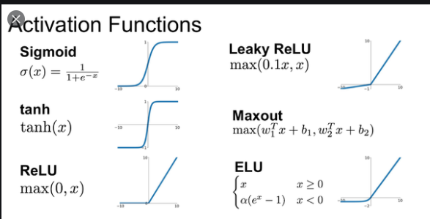
Diabetes Prediction – Analysis of code segments (2)
- Layers
building blocks for the model
receive inputs, process, produce output
output of one flows as input to another.
‘Dense’ layer is most simple
A layer is defined with
No of nodes,
No of inputs (for the input layer only)
Activation type.
relu
sigmoid
Source: https://www.tutorialspoint.com/keras , https://www.quora.com/What-is-ReLU-and-Softmax

Slide 8
Diabetes Prediction – Analysis of code segments (3)
- Compile
Last step in creating the model.
Training can start after this step.
Compile inputs
Loss
Find the error in the learning process
One method is binary cross entropy -> helps in multilabel classification of binary type
Example : Is someone tall, speaks English, goes to college etc. at the same time.
Source: https://www.tutorialspoint.com/keras, https://peltarion.com/knowledge-center/documentation/modeling-view/build-an-ai-model/loss-functions/binary-crossentropy , https://keras.io/api/optimizers/adam/

Slide 9
Diabetes Prediction – Analysis of code segments (4)
- Compile inputs (contd.)
Optimizer
This adjusts the input weights with respect to the error (loss above) and prediction from the model
One method is ‘Adam’ which is gradient descend by nature and takes in the learning rate as input.
Metrics
Evaluate performance of the model
One way is using ‘accuracy’
This calculates how many times the predicted value matched the desired value.
Source: https://www.tutorialspoint.com/keras, https://keras.io/api/optimizers/adam/, https://keras.io/api/metrics/accuracy_metrics/

Slide 10
Diabetes Prediction – Analysis of code segments (5)
- Compile inputs (contd.)
Optimizer
This adjusts the input weights with respect to the error (loss above) and prediction from the model
One method is ‘Adam’ which is gradient descend by nature and takes in the learning rate as input.
Metrics
Evaluate performance of the model
One way is using ‘accuracy’
This calculates how many times the predicted value matched the desired value.
Source: https://www.tutorialspoint.com/keras, https://keras.io/api/optimizers/adam/, https://keras.io/api/metrics/accuracy_metrics/

Slide 11
Diabetes Prediction – Analysis of code segments (6)
- Fit
Training the model
Define training data set (inputs, desired output)
Define Epoch
Define Batch Size.
Evaluate
Evaluate performance of the model
Takes in the input data, expected output.
Gives the results as per the metric chosen
Source: https://www.tutorialspoint.com/keras, https://keras.io/api/optimizers/adam/, https://keras.io/api/metrics/accuracy_metrics/, https://www.tutorialspoint.com/keras/keras_model_evaluation_and_prediction.htm

Slide 12
Diabetes Prediction – Analysis of code segments (7)
- Predict
Give output for previously unseen input data
‘Predict_class’ method used to get class (or bucket) in classification problems
Only available in sequential models
Steps:
Get the dataset
Define the model
Fit the model
Evaluate the model
Predict from the model.
Source: https://www.tutorialspoint.com/keras/keras_model_evaluation_and_prediction.htm, https://stackoverflow.com/questions/51382524/what-is-the-difference-between-predict-and-predict-class-functions-in-keras

Slide 13
Course Roadmap

Slide 14
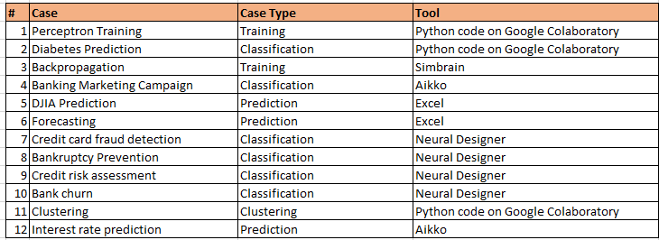
Cases & Tools

Slide 15
Prediction of the Dow Jones Industrial Average (DJIA)

Slide 16
Preprocessing of data
Two techniques are used
Transformation
On raw output to convert a single point of data to a net
Reduce number of inputs to the network
Smoothening of data – filter out the ‘noise’
Trade off between losing information and filtering the noise.
Normalization
Done on the single piece of data to put it in an acceptable range for the network.
Type 1 : Input data is between a minimum and a maximum (linear)
Type 2 : Use mean and variance in data (statistics) to remove outliers. Puts limit on what the minimum and maximum value can be.
Source: https://www.vantagepointsoftware.com/mendelsohn/preprocessing-data-neural-networks/

Slide 17
DJIA
The Dow Jones Industrial Average (DJIA):
Is also referred to as Dow 30
Is a stock market index that consists of 30 large, publicly-owned blue chip companies
That trade on the New York Stock Exchange (NYSE) and the NASDAQ
The companies are not static but are added or removed according to their relevance to the economy
Indicator of the health of the US economy.
Source: https://www.investopedia.com/terms/d/djia.asp

Slide 18
DJIA : Prediction task
Input
Raw data
Transformed to
Date | Open | High | Low | Close | Volume | Adj Close
2000-01-03 | 11501.85 | 11655.65 | 10862.66 | 11522.56 | 1068760000 | 11522.56
2000-01-10 | 11532.48 | 11908.5 | 11385.74 | 11722.98 | 1033940000 | 11722.98
2000-01-18 | 11719.19 | 11834.67 | 11113.65 | 11251.71 | 1113750000 | 11251.71
Date | MA_5 | MA_10 | MA_20 | MA_60 | MA_120 | Target
2002-04-22 | 10206.85 | 10297.863 | 10118.79 | 10127.81 | 10409.4 | 10006.63
2002-04-29 | 10127.38 | 10301.711 | 10128.57 | 10120.15 | 10396.77 | 9939.92 | <= 10006.63 is the Closing Price On 4/29/2002
2002-05-06 | 10061.04 | 10258.817 | 10123.8 | 10108.41 | 10381.91 | 10353.08 | <= 9939.92 is the Closing Price On 5/6/2002
Source: https://www.investopedia.com/terms/d/djia.asp

Slide 19
DJIA : Prediction task
Input to our model
Moving averages for
5 days
10 days
20 days
60 days
120 days
Moving average :
Used in technical analysis of stocks -> trends in price behaviour
Used to flatten variations in the short term
Average over the given amount of days.
What is the dimensionality?
We will partition the data for
Training (70%)
Testing (30%)
Source: http://www.xlpert.com/software-4Cast-XL.html

Slide 20

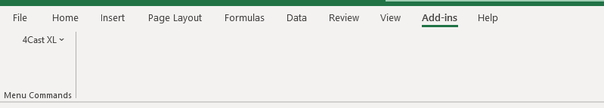
DJIA : Prediction task
Install the Excel plugin.
Open the Excel file -> Dow_Weekly
Click on the 4Cast XL Excel plugin
Click on the Enable Macros button when prompted.
Confirm that the link is there on the top ribbon.
Clicking on that ribbon should display the following.
Source: http://www.xlpert.com/software-4Cast-XL.html

Slide 21
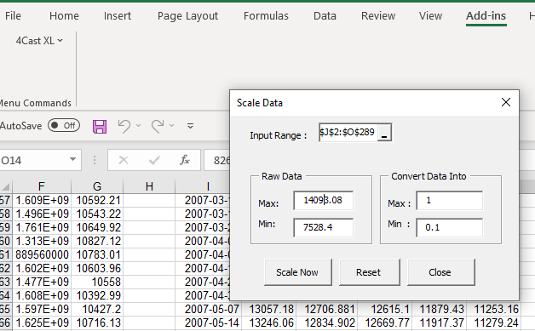
DJIA : Prediction task - 1
Delete the Worksheet named Network Output
Step 1 : Scale the data
Choose scale data from the add-in
Choose the input range
Choose 1 as max and 0.1 as min.
Click on Scale On button.
Source: http://www.xlpert.com/software-4Cast-XL.html

Slide 22
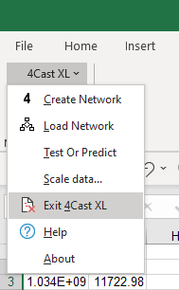
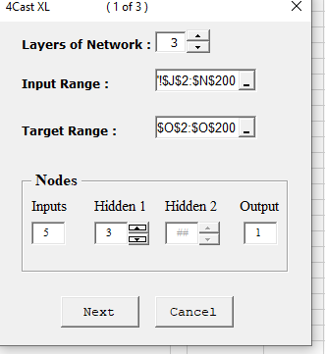
DJIA : Prediction task - 2
Step 2 : Create the Network
Choose Create Network from the menu
Enter parameters as shown
Click Next
Source: http://www.xlpert.com/software-4Cast-XL.html

Slide 23
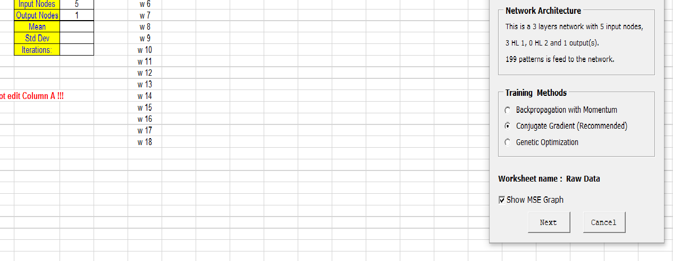
DJIA : Prediction task - 3
Step 3 : Configure the Network
Choose the training method
See other parameter as shown
Verify the Network Output worksheet
Click Next
Source: http://www.xlpert.com/software-4Cast-XL.html

Slide 24
DJIA : Prediction task - 3
What is the dimensionality?
- Can you calculate the number of weights?
Source: http://www.xlpert.com/software-4Cast-XL.html

Slide 25
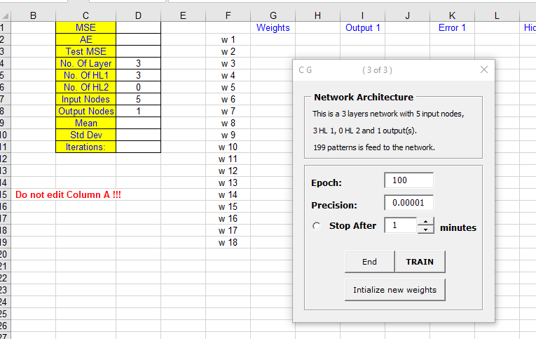
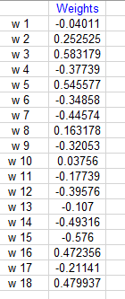
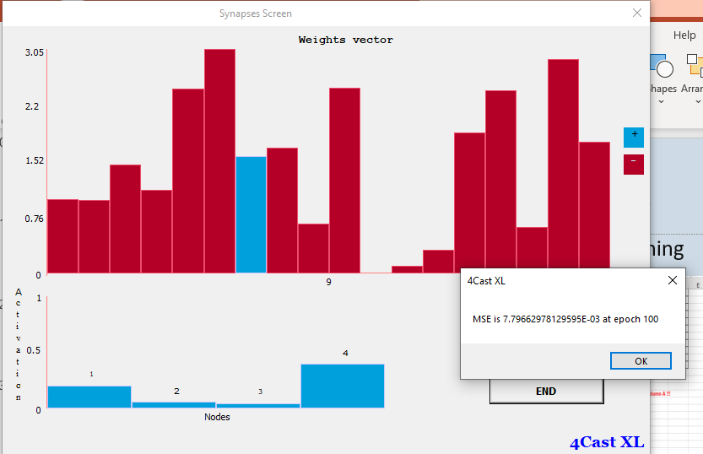
DJIA : Prediction task - 4
Step 4 : Configure the Network for Training
Choose parameters as shown
Click on initialize new weights
Click Train to see screen below
Source: http://www.xlpert.com/software-4Cast-XL.html

Slide 26
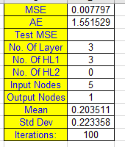
DJIA : Prediction task - 5
Step 5 : Evaluate Training
See graph of MSE Vs Epoch as below
Check Network Output tab for details
Compare calculated vs desired outputs
Source: http://www.xlpert.com/software-4Cast-XL.html

Slide 27
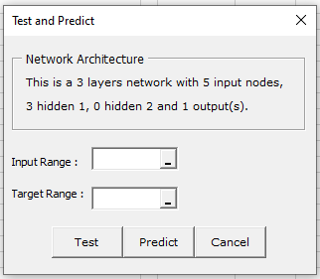
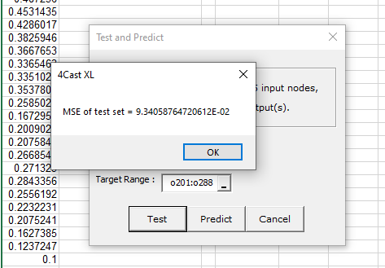
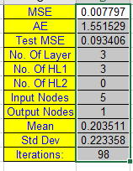
DJIA : Prediction task - 6
Step 6: Test
Choose test or predict from the 4CastXL menu
Choose J201:J288 as input range
Choose O201:O288 as Target range
Click on the Test button to get confirmation
Source: http://www.xlpert.com/software-4Cast-XL.html

Slide 28
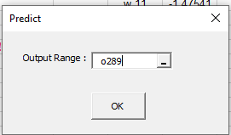
DJIA : Prediction task - 7
Step 7 : Predict
Choose test or predict from the 4CastXL menu
Choose J289:N289 as input range
Choose Target range as blank
Fill in the output range as below
See output in blue
Source: http://www.xlpert.com/software-4Cast-XL.html

Slide 29
DJIA : Prediction task - 8
Step 8 : Reverse scale to get value
Choose scale data
Input range 0289
Choose min and max in reverse order
Get value
Source: http://www.xlpert.com/software-4Cast-XL.html

Slide 30
Session summary -------------------------------------------------------------
Keras is a framework for deep learning for python.
Excel based plug-ins are available for forecasting via neural networks.

Slide 31
References ------------------------------------------------------------- https://barnraisersllc.com https://www.tutorialspoint.com/keras https://www.quora.com/What-is-ReLU-and-Softmax https://peltarion.com/knowledge-center/documentation/modeling-view/build-an-ai-model/loss-functions/binary-crossentropy https://keras.io/api/ http://www.xlpert.com/software-4Cast-XL.html

Slide 32
Topics for next session
Neural Networks – Concepts & Practical examples

Slide 33
End of Session ------------------------------------------------------------------ Questions

